Slide 1
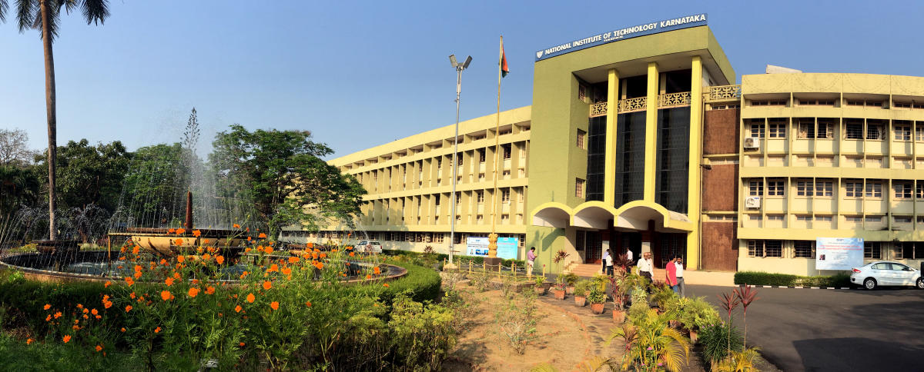

Slide 2
Project on:- DATA STRUCTURE
ALGO-CITY

Slide 3
INTRODUCTION:-
Basically this project is consisted of two methodologies :-
1. Data Structures : -
For data structure, here we implement the linear(Array) and Non-Linear(Graph) data structure .
2. Algorithm : - ( Algorithm portion we implement three algorithms)
A . Selection Sort Algorithm:- This is for just to sort the compiled data.
B . Sequential Search Algorithm:- To search the data through the given key by the user.
C . Dijkstra's Algorithm:- This algorithm is used to find the minimum distance between two Nodes .

Slide 4
What is linear(Array) and Nonlinear(Graph) data structures?
LINEAR(ARRAY) DATA STRUCTURE :-
An array is a collection of elements of the same type placed in contiguous memory locations that can be individually referenced by using an index to a unique identifier.
NON-LINEAR DATA STRUCTURE:-
A Graph is a non-linear data structure consisting of nodes and edges. The nodes are sometimes also referred to as vertices and the edges are lines or arcs that connect any two nodes in the graph.

Slide 5
What is Algorithm ?
The word Algorithm means “a process or set of rules to be followed in calculations or other problem-solving operations”. Therefore Algorithm refers to a set of rules/instructions that step-by-step define how a work is to be executed upon in order to get the expected results.

Slide 6
Header files :-
#include<iostream> :- Iostream is used to invoke the commonly used functions like cout,cin in a C++ program. Iostream stands for input output stream. ... It is used to include the header file “conio” in a program.
#include<map> :- Maps are a part of the C++ STL. Maps are associative containers that store elements in a combination of key values and mapped values that follow a specific order.
#include<list> :- C++ List is the inbuilt sequence containers that allow non-contiguous memory allocation.
#include<set> :- Set is a container implemented in C++ language in STL and has a concept similar to how set is defined in mathematics. The facts that separates set from the other containers is that is it contains only the distinct elements and elements can be traversed in sorted order.
#include<climits> :- This header defines constants with the limits of fundamental integral types for the specific system and compiler implementation used. Values of INT_MAX and INT_MIN may vary from compiler to compiler.

Slide 7
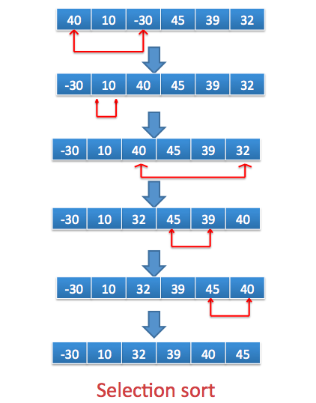
Selection Sort Algorithm :-
In Algo-city we are sorting our country data with respect to population and area of each state . The selection sort algorithm sorts an array by repeatedly finding the minimum element (considering ascending order) from unsorted part and putting it at the beginning. It has an O(n2) time complexity.

Slide 8
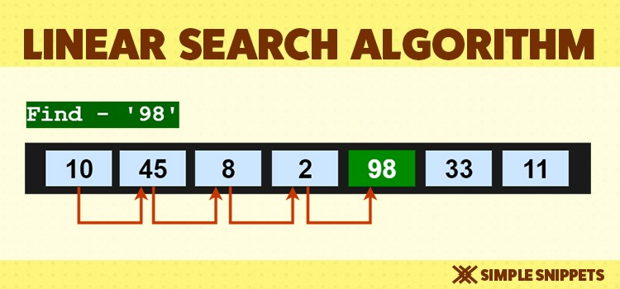
Sequential Search Algorithm :-
In Algo-city we are are sequentially searching any state data of INDIA i.e capital, chief_minister, population, area, official_language .
Linear search is a very simple search algorithm. In this type of search, a sequential search is made over all items one by one. Every item is checked and if a match is found then that particular item is returned, otherwise the search continues till the end of the data collection.

Slide 9
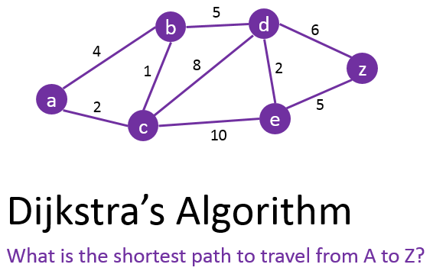
Dijkstra's Algorithm :-
This algorithm plays an important role in our project for finding the shortest distance between any state of india by taking capital name of that particular state and after the algorithm is applied it gives the exact smallest distance of the two different states .
For example :- Goa’s capital is Panaji, so we type Panaji in case 3 i.e Dijkstra algo so we find the shortest distance from Goa to all other 27 states .
if the nodes of the graph represent cities and edge path costs represent driving distances between pairs of cities connected by a direct road (for simplicity, ignore red lights, stop signs, toll roads and other obstructions), Dijkstra's algorithm can be used to find the shortest route between one city and all other cities.

Slide 10
Conclusion:-
In this project we have successfully implemented the linear data structure which is Array and non linear data structure which is Graph is just to see the stored related data which is easy to access and user friendly. And here we also implemented some standard Algorithms.

